Slide 1

Python! Day 18
Warm up: add to Pong
Read and use CSV files
Use the pandas module

Slide 2
Warm-up: Things to Add to Pong
Make the screen look more like the original Pong (dashed line down the middle)
Make the game end and declare one player the winner if they score 15 points
Track the game’s high score using a file
Anything else you can think of!
To start, let’s try adding something to our Pong game.
Here are some options of things we can add

Slide 3

Data Files in Python
A couple of weeks back, we learned how to read and use text files in Python, today, we’ll be learning how to use a different type of file
CSV (comma-separated values) files are commonly used with Python to hold a table of data
Each column of the table is separated by a comma
CSV files are useful to be able to use large tables of data in our projects

Slide 4
Day of the Week | Weather Conditions | Average Temperature
Monday | rainy | 44
Tuesday | rainy | 43
Wednesday | cloudy | 43
Thursday | sunny | 44
Friday | sunny | 49
Saturday | sunny | 53
Sunday | sunny | 56
A CSV file for this table might look like this:
day_of_the_week,weather_conditions,avg_temp
Monday,rainy,44
Tuesday,rainy,43
Wednesday,cloudy,43
Thursday,sunny,44
Friday,sunny,49
Saturday,sunny,53
Sunday,sunny,56

Slide 5

Downloading Today’s Files
Today, we’re going to use some pre-made CSV files
To download them, let’s go to the online repository I made
Link: https://github.com/Tavishi27/Tuesday-Python-Files
Then, we can download the files by clicking on the branch dropdown and pressing 3-12
Now, we can click on a file and download it

Slide 6
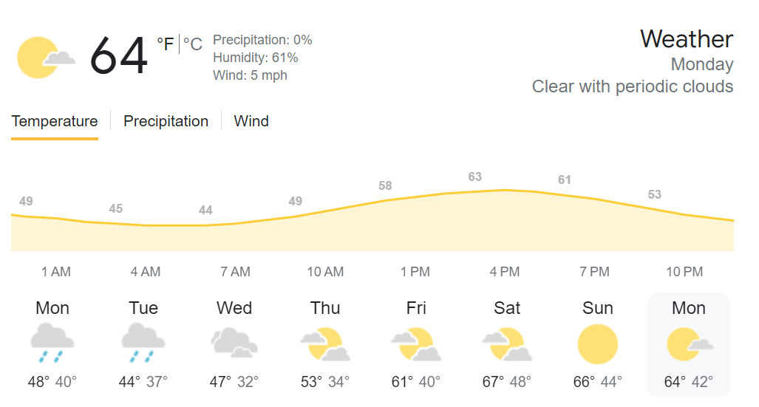
Setting Up Our Weather Project
Let’s set up today’s projects by creating a new Python project called Data File Practice
After we create our main.py file, let’s download the weather_data.csv file
Next, let’s drag the CSV file into our project and press ‘refactor’

Slide 7

Reading CSV Files like Text Files
Let’s try accessing the data in this weather CSV file using the open() function and file.readlines() to create a list with the data in the file
with open(“weather_data.csv”) as data_file:
data = data_file.readlines()
print(data)
When we print our list of data, we can see how annoying it will be to separate each data value into separate lists to make the data useable
Instead of doing this, we can import and use the csv module

Slide 8

Reading CSV Files
To make it easier to deal with CSV files, let’s write ‘import csv’ at the top of our program.
Next, we can use the csv.reader() method to separate our csv data file into something more usable
data = csv.reader(data_file)
for row in data:
print(row)

Slide 9

Using the CSV Module
Let’s use this organized data to create a list of all the temperatures in the data with each of the values as an int instead of a string
We can do this like this:
with open("weather_data.csv") as data_file:
data = csv.reader(data_file)
temperatures = []
for row in data:
if row[1] != "temp":
temperatures.append(int(row[1]))
print(temperatures)
We must make sure we don’t include the column label in our list because we’d get an error if we try to convert it into an int

Slide 10

The Pandas Module
Having to do all these steps to get the temperature data from our csv file is still a bit annoying, so let’s try an even easier way of accessing this data
To do this, we’ll use the pandas module, which is a really useful tool to get data from CSV files
To download pandas: Main Menu > Settings > Project:DataFileProject > Python Interpreter > +
Now, search ‘pandas’ in the search bar, click on the pandas module, and press ‘install package’

Slide 11

The Pandas Module
Now, let’s write ‘import pandas’ at the top of our program and use the pandas.read_csv() method to access our data
import pandas
data = pandas.read_csv("weather_data.csv")
print(data)
If we want to access the temperature data, we can write this:
print(data[“temp”])
Or we can write:
print(data.temp)
This is much simpler and easier than using the csv module

Slide 12

How Does the Pandas Module Work?
One thing that’s important to coding using pandas is understanding how the pandas module works
When we write data = pandas.read_csv("weather_data.csv"), pandas creates a DataFrame object, which is the equivalent of the table.
data = pandas.read_csv("weather_data.csv")[“temp”] or data = pandas.read_csv("weather_data.csv").temp, pandas creates a Series object, which is like a list
The pandas online documentation has a lot of information on what to do with DataFrame and Series objects

Slide 13

Some Useful Pandas Functions
DataFrame.to_dict() = converts the DataFrame object into a dictionary
Series.to_list() = converts the Series object into a list
Series.max() = returns the maximum value of a series
Series.mean() = returns the average value of a series
Use these to print the average temperature, the maximum temperature, and the number of temperatures in the csv data
import pandas
data = pandas.read_csv("weather_data.csv")
print(data.temp.mean())

Slide 14
Accessing Rows Instead of Columns
So, we know we can access a column of our data like this:
data[“temp”] or data.temp
We can also access a row of our data like this:
data[data.day == “Monday”]
Try using this to print out the row with the maximum temperature

Slide 15

Using Pandas to Create a Data Frame Object
Like with text files, we can create CSV files in Python
To do this, let’s create a dictionary where each key has a list as a value to create a 2-Dimensional Dictionary
dictionary = {
"names" : ["Alex", "Michael", "Emily", "Amanda", "Josh"],
"ages" : [17, 12, 14, 9, 8],
"birthdays" : ["3/20", "4/15", "7/27", "2/2", "12/31"]
}
Now, we can convert this dictionary into a DataFrame like this:
data_frame = pandas.DataFrame(dictionary)

Slide 16
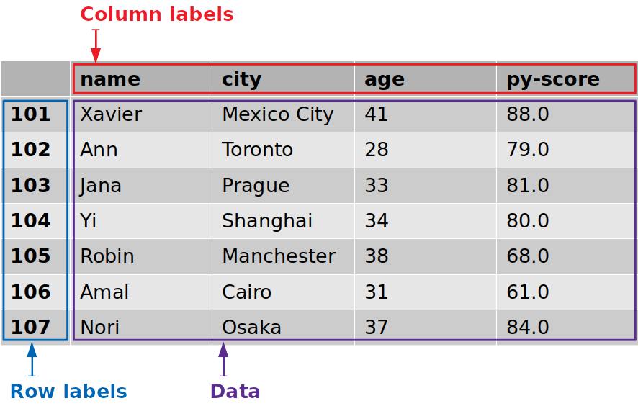
Using DataFrame to Create a CSV File
Now, we can use our newly-created DataFrame and the DataFrame.to_csv() method to create a new CSV file
Like this:
dictionary = {
"names" : ["Alex", "Michael", "Emily", "Amanda", "Josh"],
"ages" : [17, 12, 14, 9, 8],
"birthdays" : ["3/20", "4/15", "7/27", "2/2", "12/31"]
}
data_frame = pandas.DataFrame(dictionary)
data_frame.to_csv("people.csv")

Slide 17

Project: Create a New CSV Weather File with the Temperatures in Fahrenheit
You might notice that the temperatures in our CSV file are really low, this is because they are in Celsius and not Fahrenheit
Let’s try coding a program that creates a new file with the temperatures converted to Fahrenheit
Hint: Fahrenheit = 1.8 * Celsius + 32

Slide 18
